Slide 1
Novel drug target identification for the treatment of dementia using multi-relational association mining
Nguyen et al, 2015 Nature Sci Rep. 5:11104
Critical paper review by
Jasleen Grewal

Slide 2
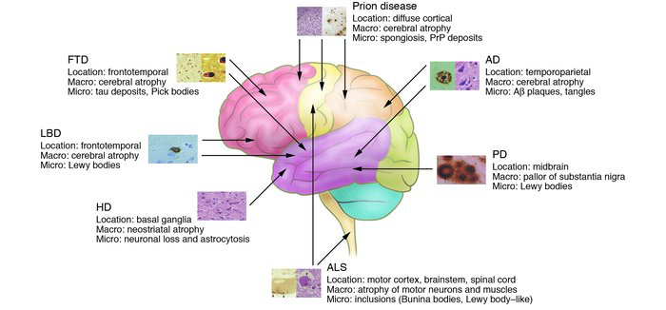
Dementia (…formerly, ‘senility’)
Central Nervous System (CNS) diseases
Degeneration and eventual death of neurons in brain, eye, spinal cord
Long term (> 6 months), gradual decrease in one’s mental functioning
Progressive supranuclear palsy
Corticobasal dementia
Pick’s disease

Slide 3
Cures for dementia?
Of the top 10 causes of death in USA, dementias are the only ones for which no therapies exist that can halt or even slow disease progression (UCSF IND)¹
>10 years since last treatment approved²
Known, pharmacologically validated targets³
Cholinesterase inhibitors – symptom alleviation
Neurodegenerative Disease Incentive Initiative, 2015.
The Dementia Consortium, UK, 2014.
New Prospects and Strategies for Drug Target Discovery in Neurodegenerative Disorders. Hilbush et al. NeuroRx. 2005 Oct; 2(4): 627-637
Notes:
Oct 22, 2015. Parkinsons disease treated by drug delivery through nose in mice models. The mucosa membrane is 1000 times more permeable than the blood-brain barrier.

Slide 4
Drug development and dementia
Studies to prove that new medicines are safe
Target brain degeneration¹
Much longer, complex, costly, prone to failure¹
98% of promising drugs prohibited by the blood-brain barrier (nasal mucosal grafting?)
Diseasemodifying therapies needed, not present
Bringing out a new drug = $6 billion cost, on average
1. Neurodegenerative Disease Incentive Initiative, 2015.
Notes:
Oct 22, 2015. Parkinsons disease treated by drug delivery through nose in mice models. The mucosa membrane is 1000 times more permeable than the blood-brain barrier.

Slide 5
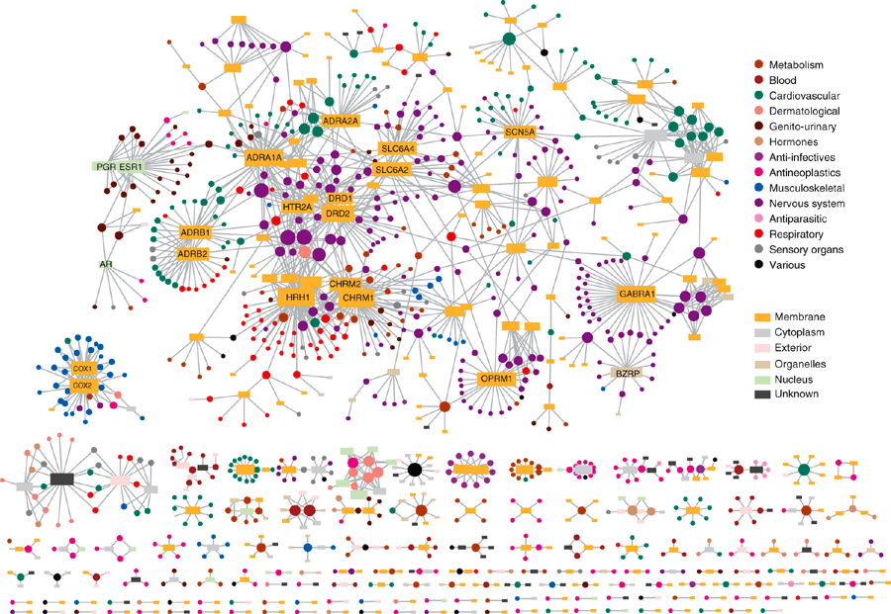
Finding drug targets
Narrow our focus for drug discovery and research
Proteins rarely function in isolation in a biological system
Interactomes
Understand the interactions of drugs with their targets, in context of the networks¹
To understand determinants of disease expression¹:
Molecular networks: protein interaction, metabolic, regulatory
Phenotypic networks: coexpression, genetic
1. Drug-target network. Yildrim, M et al. Nat. Biotechnol. 2007 25: 1119-26

Slide 6
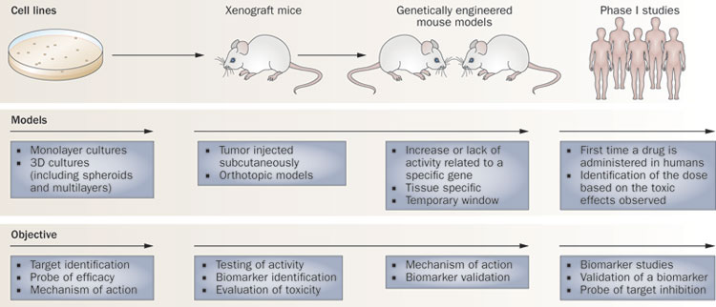
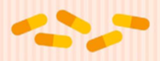
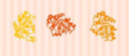
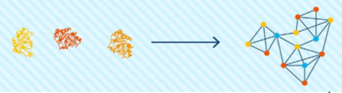
Methodology
What drugs already exist for dementia
Trial
What are their molecular targets
Build an annotated interactome of these targets
Protein interactions
Marketed
Associated Pathways
GO terms
Protein domain information
Induce association rules
Predict novel drug targets
Lab (preclinical)

Slide 7
Finding pre-existing dementia targets
DrugBank
Clinical trial database (www.clinicaltrials.gov)
Pharmaceutical company websites (how?)
Confidence score for drug development stage
Primary targets of drug
Hugo ID -> UniProt protein accession
268 Drug Target Proteins

Slide 8
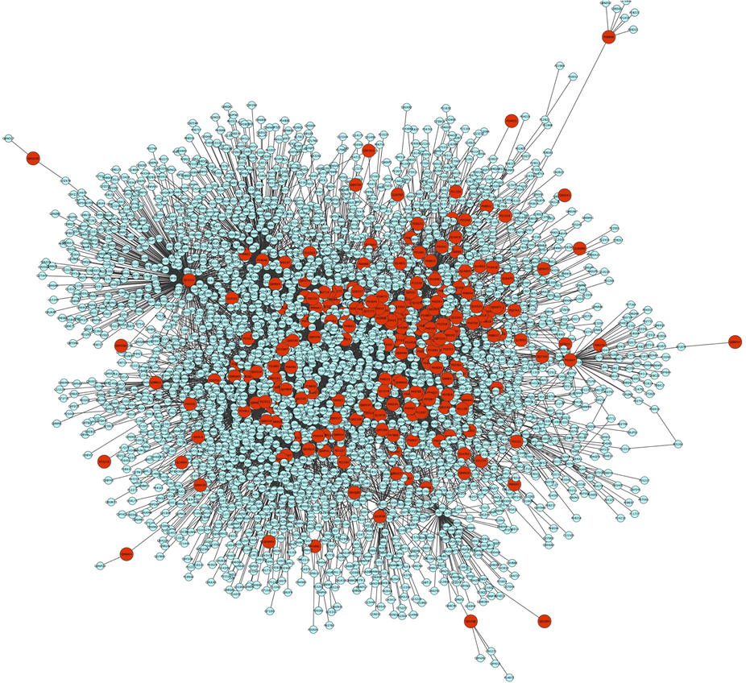
Expanding on list of dementia targets
Interologous Interaction Database (i2d)
Source Interactions - curated from other data-sources
221 Drug Target proteins had atleast 1 neighbour
N
N
Protein-protein interactions
1-step neighbor interactions only
Binary, undirected interactions
Human source interactions only
Drug1
DT¹₁
DT¹₂
DT¹₃
DT¹₄
N
N

Slide 9
Build the network – (i)
Derived from i2d
Add topological characteristics
Connectivity
Centrality
DrugBank and trials
N
n1
Drug2
DT²₁
DT²₃
DT²₂
1
N
N
N
2
3
Drug1
DT¹₁
DT¹₂
DT¹₃
DT¹₄
N
N
N
N
1
Degree Centrality Index
Articulation Points {0,1}

Slide 10
Build the network – (ii)
Add functional data – multi relational database
Many to many, one to many relationships (SQL)
DT²₁
Degree Centrality Index
DT²₁
DT²₂
1
PD 1
DT²₂
GO term 1
DT²₂
RP1
DT²₃
PD 2
RP 2
DT²₃
3
GO term 2
DT²₃
DT¹₁
PD 3
RP 3
DT¹₁
GO term 3
DT¹₁
0
DT¹₂
RP 4
DT¹₂
DT¹₂
DT¹₃
DT¹₃
DT¹₃
Gene Ontology terms
(molecular function, biological process, cellular component)
Reactome Pathways
Protein Domain (InterPro)

Slide 11
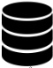
Summary so far…..
Created a multi-relational database
Next step: Multi-relational association mining (MRAM)
Learn what rules make a Drug Target!
Proteins
Reactome
Pathways
GO terms
Articulation point
Degree Centrality
Protein Domains

Slide 12
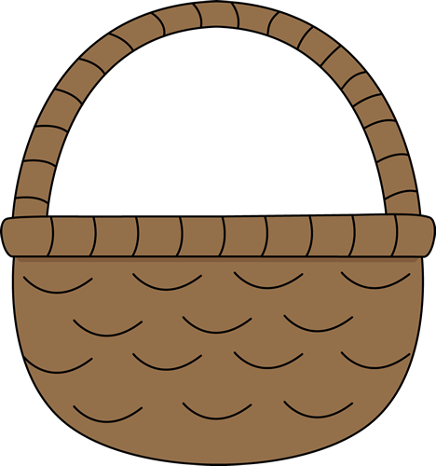

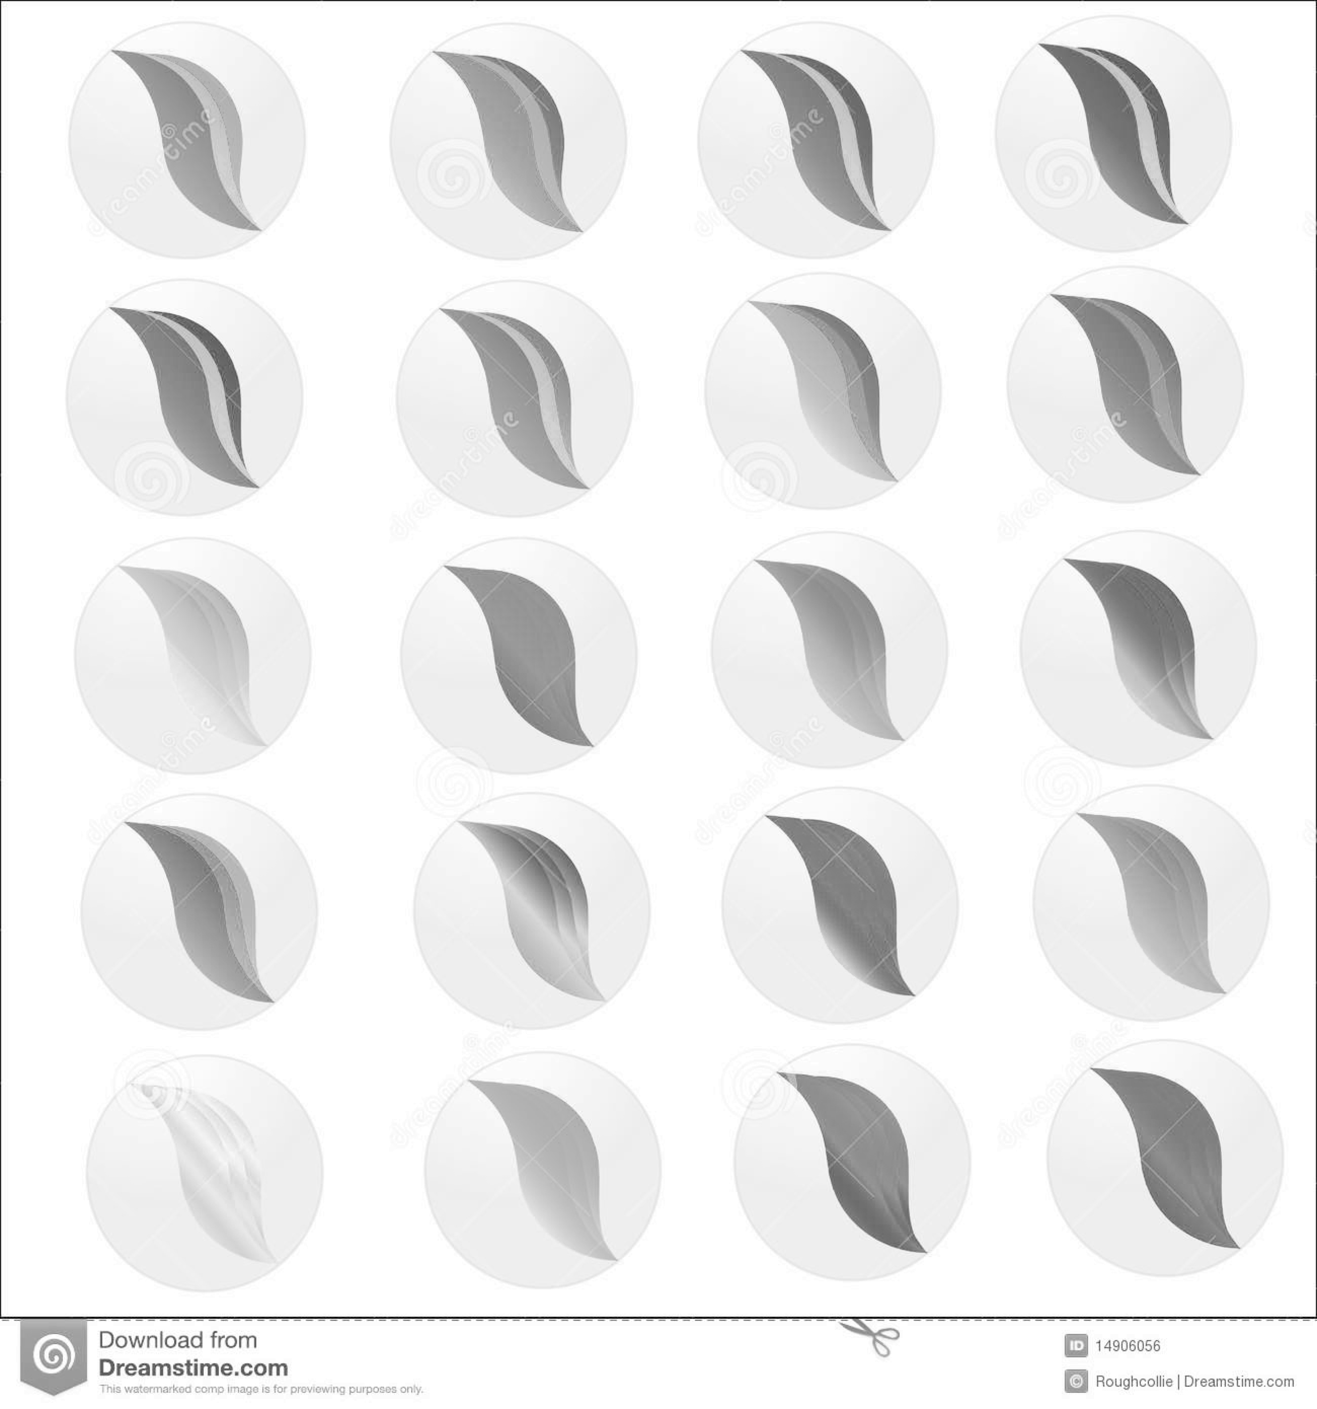
MRAM algorithm
Predict dementia Drug Targets (rules to tell me what a potential DT for dementia might ‘look like’)
Feature vector
(for every marble)
Centrality
Articulation
GO term
Reactome Pathway
Protein Domain
Known DTs
(Positive training examples)
Non-DTs
(Negative training examples)

Slide 13
MRAM algorithm
Predict dementia Drug Targets (rules to tell me what a potential DT for dementia might ‘look like’)
Like in any healthy relationship, a good association rule
X => Y must have
Support : Y must occur above a certain threshold frequency in the given dataset (Probability of a result to occur)
Confidence : X => Y occurs at a certain frequency in the given dataset (Importance – log likelihood of X, given Y)
X and Y are disjoint
Want High Probability (1) and Importance (>0.5)

Slide 14
Results
Learnt new rules (Probability = 1, Confidence > 0.5)
MRAM: Apply rules on a network of proteins -> Get new putative Drug Targets
Comparison with other methods
Decision Tree
Naïve Bayes
Neural Network

Slide 15
Results
Learnt new rules
Apply rules on a set of proteins -> Get new putative Drug Targets
Comparison with other methods
True cases = 221 DTs (1-step neighbours)
False cases = 3 randomly selected sets of non-DTs, sizes 221, 500, 1000
Network of 3112 proteins and 6541 interactions
44433 GO terms
11738 InterPro domains
4240 Reactome pathways

Slide 16
Results
Comparison with other methods
True cases = 221 New Possible DTs (1-step neighbours)
False cases = 3 randomly selected sets of non-DTs, sizes 221, 500, 1000
Lift chart: Did we do better than a random guess approach
Randomly pick out possible Drug Target genes
Use the rules learnt by my model in order to pick out DT genes
Any improvement from random guess = ‘lift’!
Graph – poor resolution (can bash at end of presentation)

Slide 17
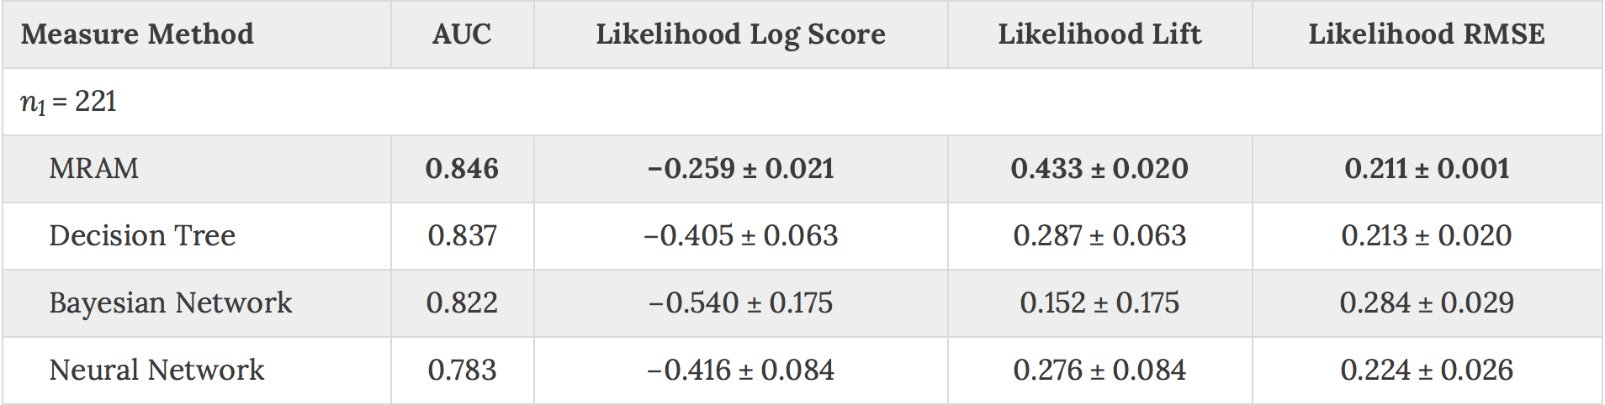
Table 2. Computational measures calculated for the 4 methods (n₁=221 is balanced set with equal number of true and false cases). 10 fold cross validation results.

Slide 18
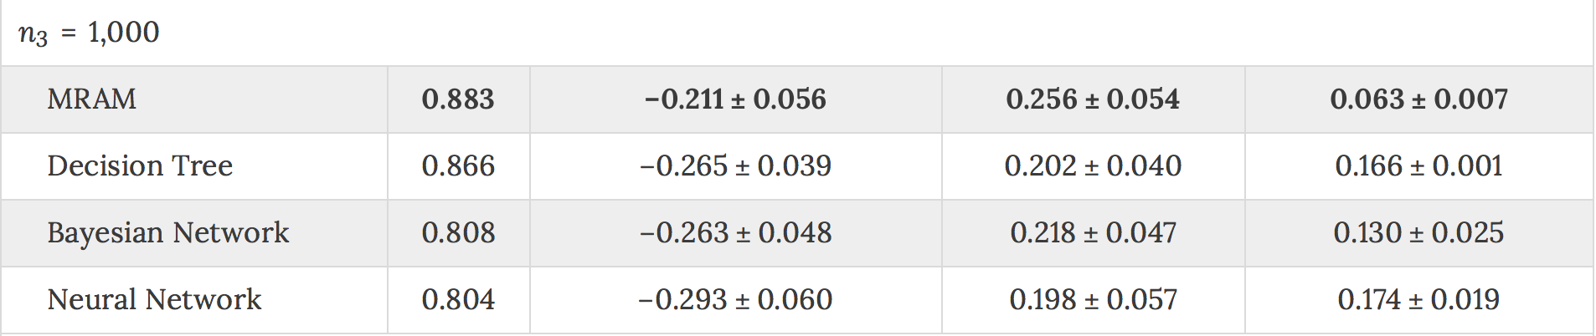
Overfitting to their input data?
Table 2. Computational measures calculated for the 4 methods (n₁=221 is balanced set with equal number of true and false cases). 10 fold cross validation results.
MRAM Rules were learnt from the 268 Drug Targets
Positive set was derived from 221 of these 268 drug targets!

Slide 19
Results
What are the new putative Drug Targets like?
p38 MAPK has recently emerged as a disease treatment target for Alzheimer's
Support for existing research – link between neurodegenerative dementia and metabolic disorders
Functional Enrichment Analysis
GO biological process terms
Metabolic-related
Pathway analysis
DAVID
Similar results as GO
Alzheimer disease-amyloid secretase pathway
Type 2 Diabetes
Cell surface receptor signaling pathways (MAPK cascade)
Immune response
Apoptosis
Long-term memory
GOrilla and REVIGO

Slide 20
What did they do well?
Integrated multiple different types of data
Interpolate data relations without merging them into one unanimous ‘mega-relation’
Good proof of concept
Learnt new rules to predict possible genetic targets, instead of clustering different genes/proteins together

Slide 21
Methodology critique
Use of interaction databases as prior knowledge
i2d source interactions (String? GeneGO?)
High-throughput experimental platforms (ex. yeast-two hybrid) known to have high false positive and false negative rates, and platform specific biases¹
Compendium sources? (WikiPathways, Pathway Commons)
1. Kirouac, Daniel C., Julio Saez-Rodriguez, Jennifer Swantek, John M. Burke, Douglas A. Lauffenburger, and Peter K. Sorger. 2012. Creating and analyzing pathway and protein interaction compendia for modelling signal transduction networks. BMC Systems Biology 6:29.
Notes:
Pathway Commons merges information from Reactome, KEGG, PANTHER, GeneGO

Slide 22
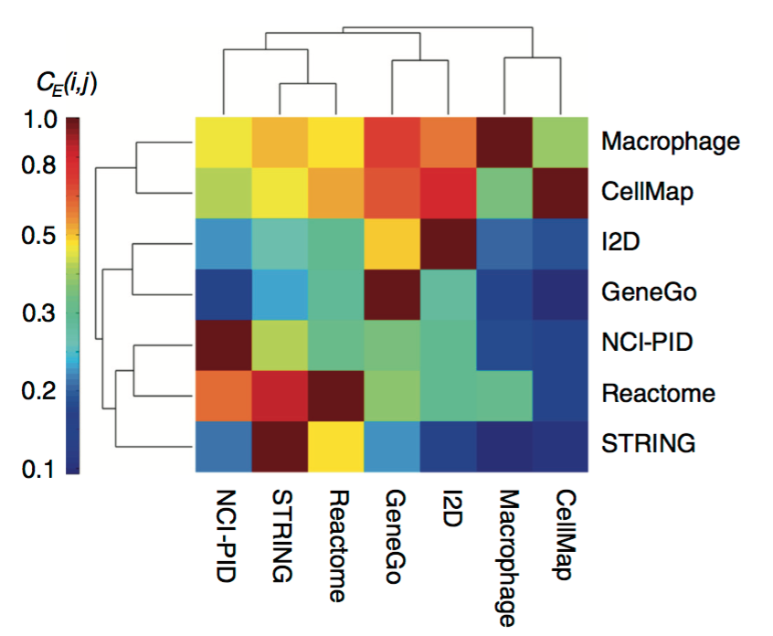
×
¹Figure 4. Edge consistency between interaction databases. The fractional edge overlap scroes (proportion of interactions consistent between 2 databases) are represented as a hierarchically clustered heatmap.
1. Kirouac, Daniel C., Julio Saez-Rodriguez, Jennifer Swantek, John M. Burke, Douglas A. Lauffenburger, and Peter K. Sorger. 2012. Creating and analyzing pathway and protein interaction compendia for modelling signal transduction networks. BMC Systems Biology 6:29.

Slide 23
Results critique
False cases sets
Randomly selected sets of non-Drug Targets
What if these are n-step neighbours of known Drug Targets (n > 1)?
i.e. Excludes pathway interactions beyond 1-neighbour
Accuracy of prediction
Rules were learnt from the 268 Drug Targets
Positive set was derived from 221 of these 268 drug targets!
Overfitting?
GOrilla terms enrichment is based on the ‘top’ of a ranked gene list.

Slide 24
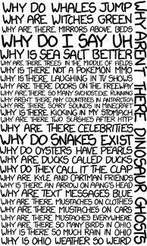
Questions?

Slide 25
Multi relational data mining¹
Traditional Data Mining (Knowledge Discovery in Databases)
Discover a high level knowledge from lower levels of relatively raw data
MRDM: Handle multiple relations at the same time (Inductive Logic Programming)
Classification: Separate data into distinct classes, supervised.
Clustering: Separate data into distinct classes, unsupervised.
Association: Discover relations between variables in the data, using real valued prediction variables. Rule learning.
Reactome
Pathways
Proteins
GO terms
1. Domingos, P. Prospects and challenges for multi-relational data mining. ACM SIGKDD Explor. Newsl. 5, 1–4 (2003).

Slide 26
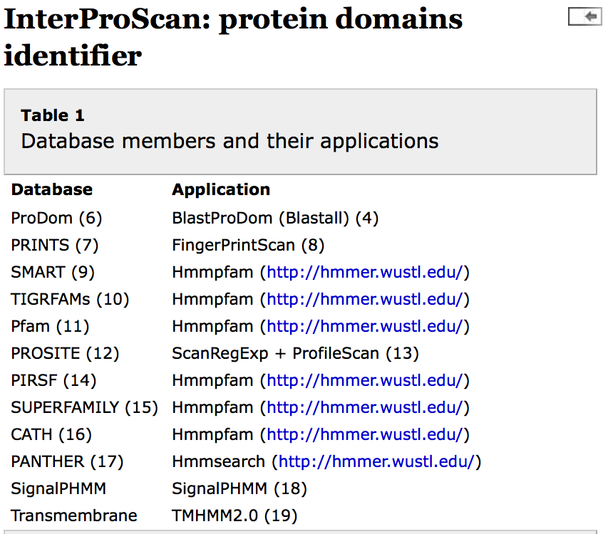
InterPro
Uses predictive signatures (from numerous databases) in order to classify proteins, and predict the presence of domains and important sites.
Combines protein function recognition methods of member databases of InterPro into one application.

Slide 27
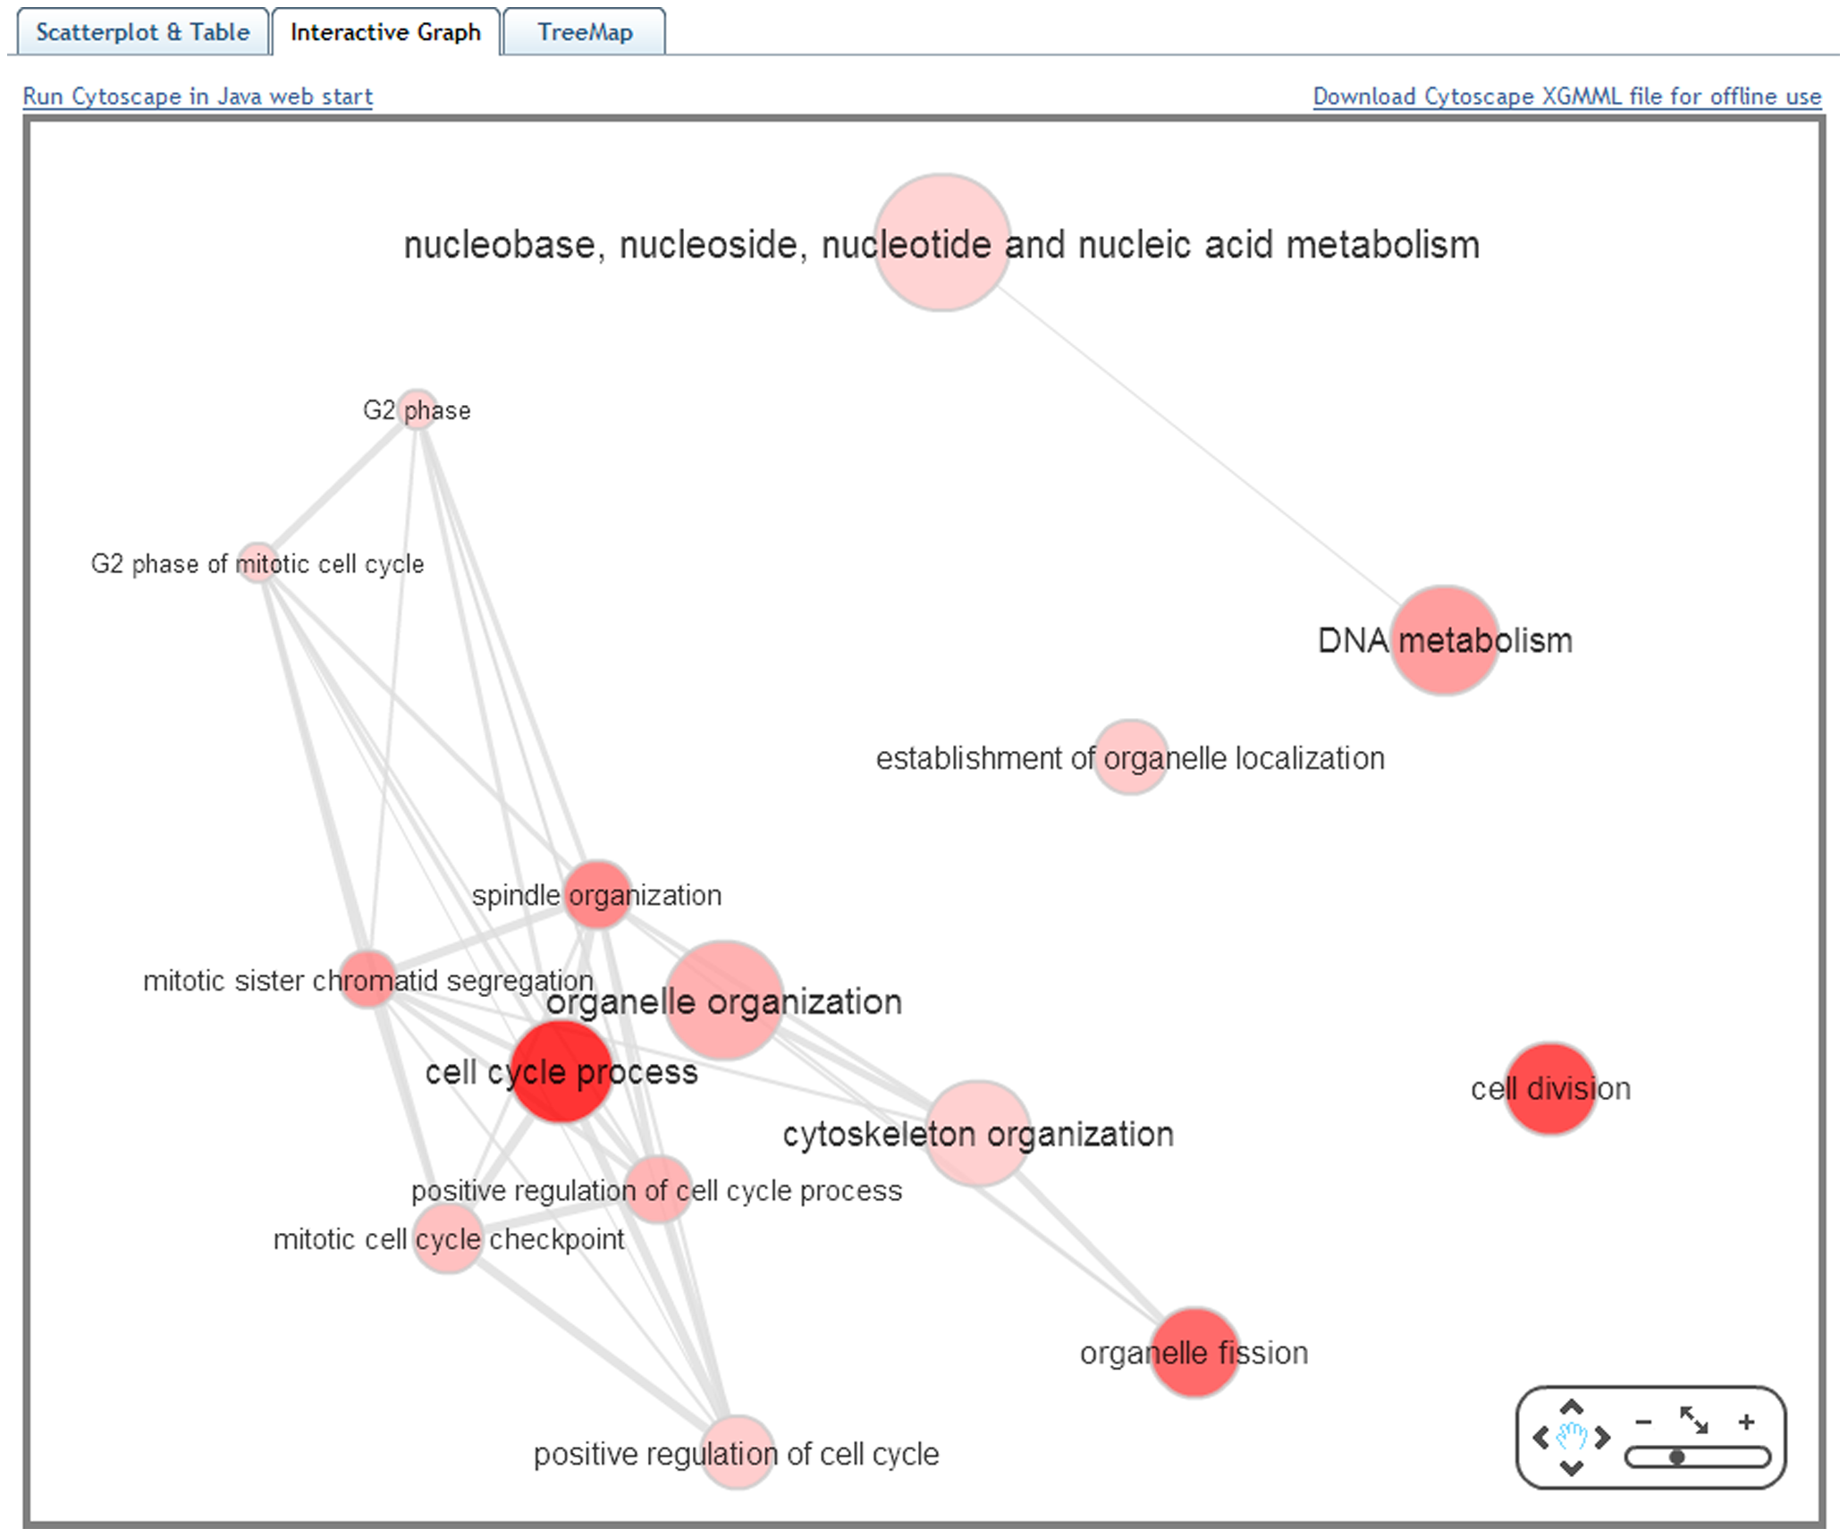
REVIGO
Takes in list of GO terms (with associated p-values)
Finds representative subset of terms using a clustering algorithm

Slide 28
GOrilla
Process/Function/Component/All ontologies
Identifies the list of GO Terms enriched in a list of genes
Statistical model to identify which GO terms are enriched significantly at the *TOP* of a ranked gene list

Slide 29
DAVID
Database for Annotation, Visualization, and Integrated Discovery
Annotation tools for Gene function
Can identify which biological ‘themes’ are enriched (GO terms)
Which pathways are enriched (KEGG and BioCarta)
Uses a population background for enrichment analysis
Corresponding genome-wide genes with atleast one annotation in the analyzing categories

Slide 30
Finding drug targets
Known, pharmacologically validated targets¹
Classical neurotransmitter or neuropeptide systems
Except for Parkinson’s, no logical relationship exists between any transmitter system and the circuitry affected by a neurodegenerative process¹
No disease modifying therapies approved for Alzheimer’s or Parkinson’s.
To understand determinants of disease expression:
Molecular networks: protein interaction, metabolic, regulatory
Phenotypic networks: coexpression, genetic
1. New Prospects and Strategies for Drug Target Discovery in Neurodegenerative Disorders. Hilbush et al. NeuroRx. 2005 Oct; 2(4): 627-637

Slide 31
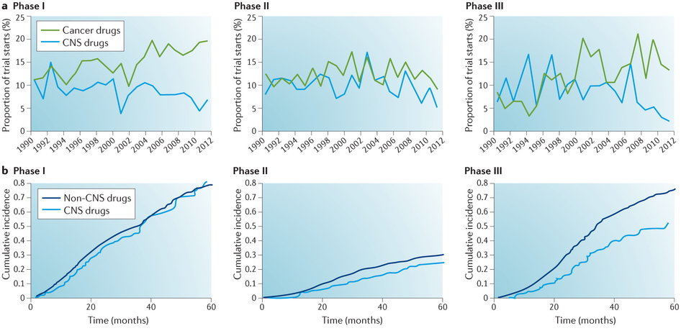
Trends in drugs entering clinical trials for central nervous system disorders compared with other therapeutic areas: 1990–2012.
1. Kesselheim et al. Two decades of new drug development for central nervous system disorders. Published online 20 November 2015.

Slide 32
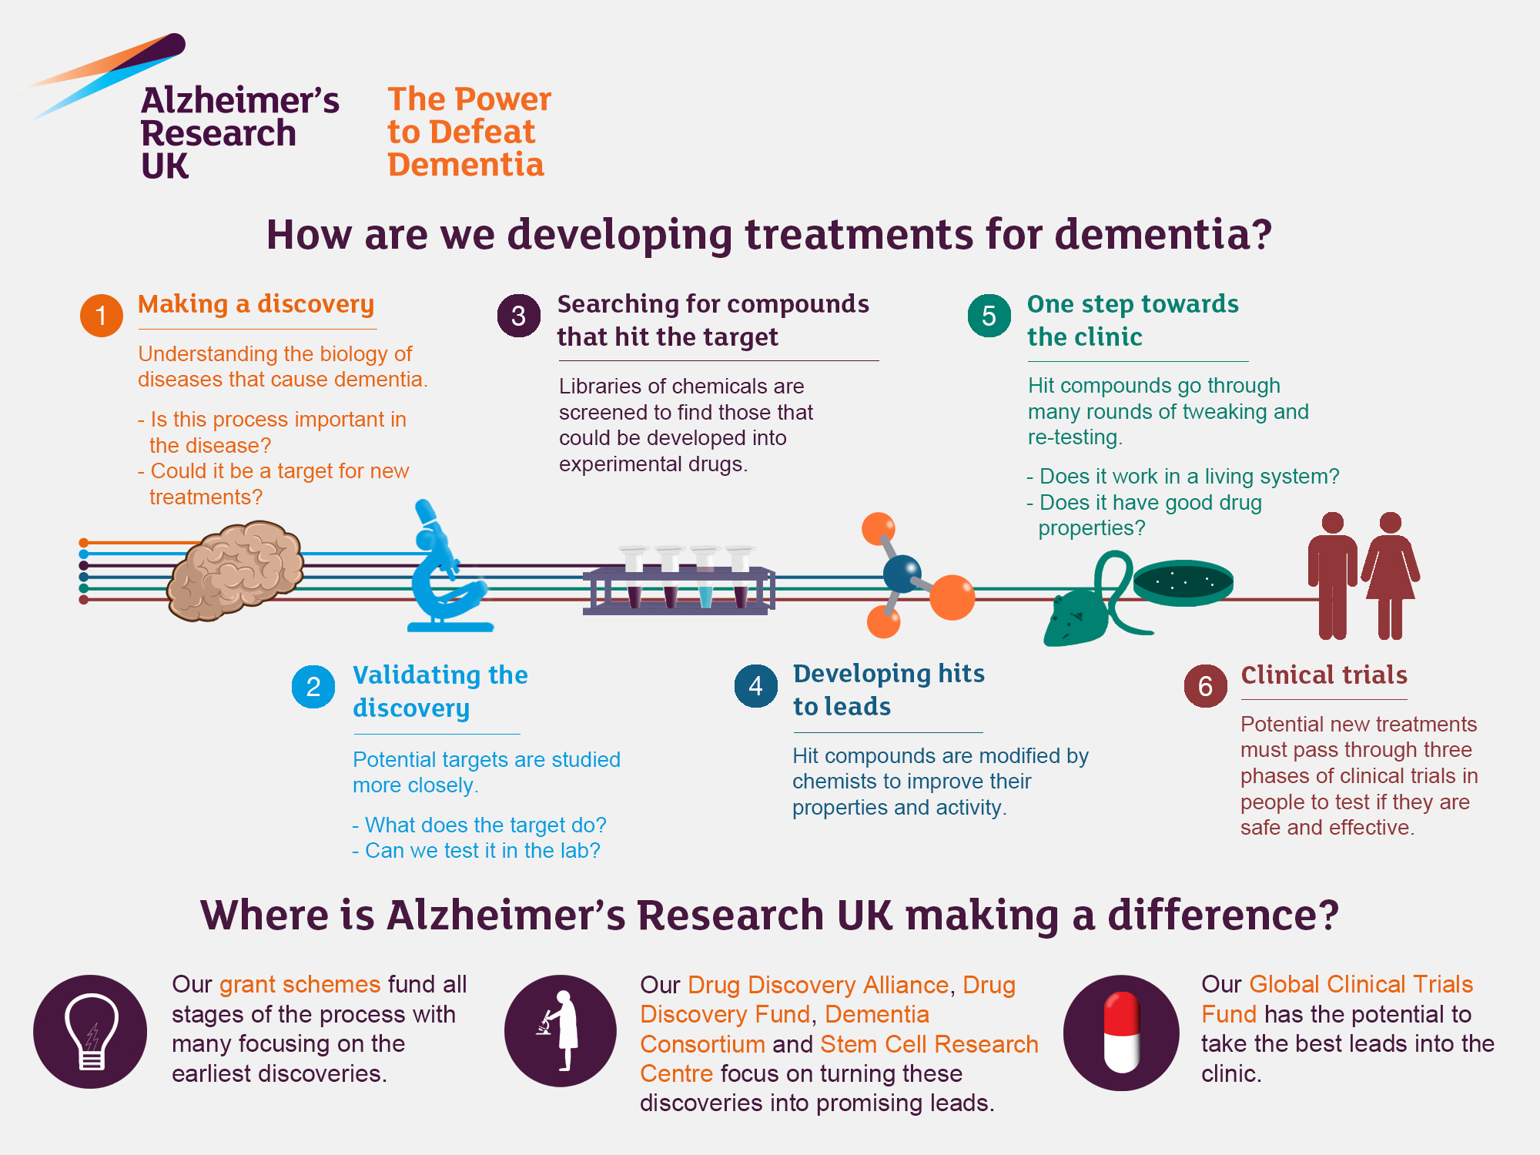
Neurodegenerative diseases
Central Nervous System (CNS) diseases where neurons in the brain, eye, spinal cord undergo progressive degeneration and eventual death

Slide 33
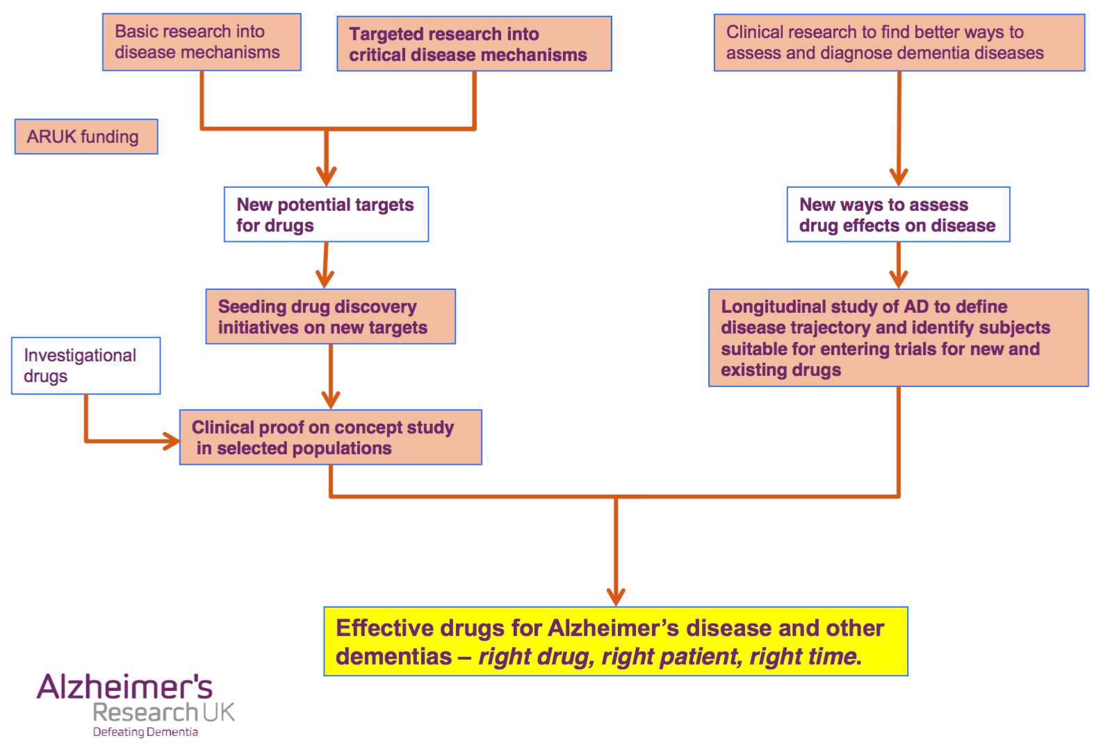

Slide 34
Orphan Drug Act
Offered incentives to pharmaceutical companies to invest in dieases where there would otherwise be no compleling economic argument to allocate resources
300 “orphan drugs” approved under its provisions
Gives market exclusivity for 7 years (originally 5)

Slide 35
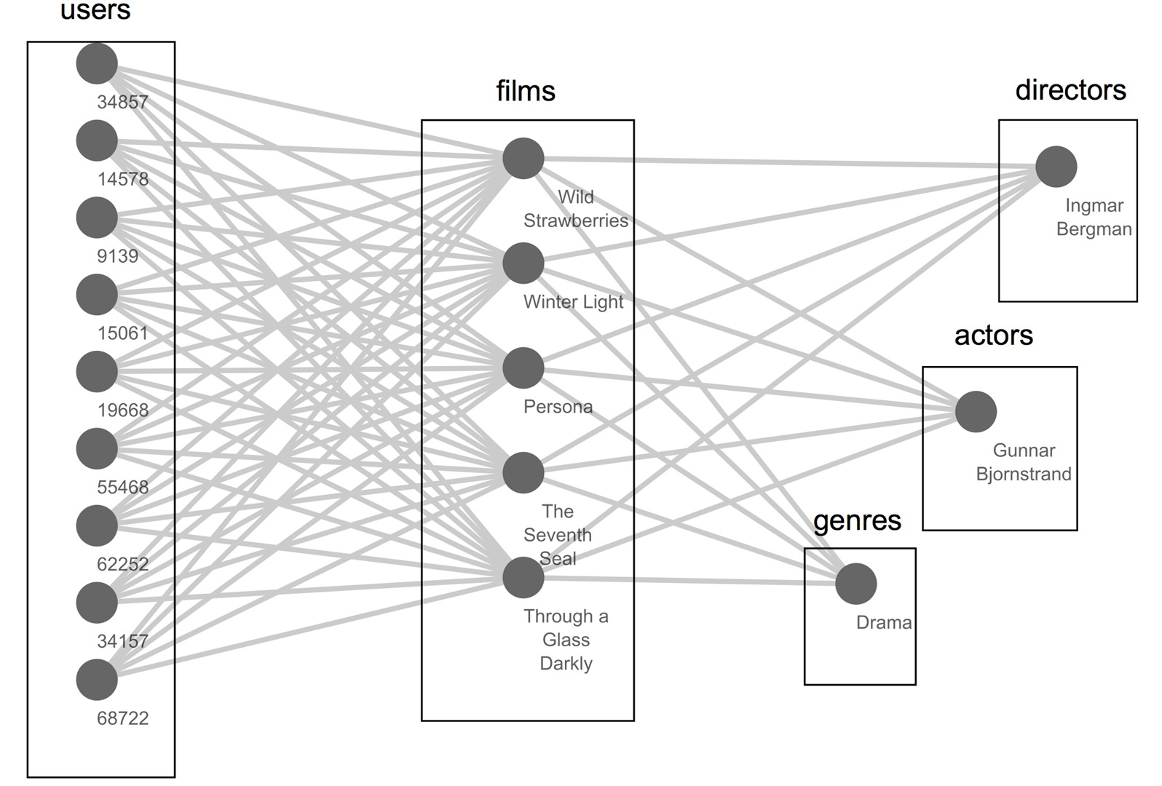
The novelty – multi relational association mining
Created a multi-relational database
Multi-relational data mining
Reactome Pathways
---------
Proteins
---------
GO terms
---------
Protein Domains
---------
Centrality
---------

Slide 36
Our novelty: Multi relational association mining
Multi Relational Data Mining
Compact data representation
No pre-processing required (Integration with relational database)
Explore multiple data from multiple data sources
Mining Association Rules
Given a database with a type of transactions,
Find all rules that correlate presence of one set of items with that of another set of items
Classically, does not work for multiple, heterogeneous sets of transactions
Enter: MRAM (part of SQL Server 2012 Analysis Services)
Predict dementia Drug Targets (rules to tell me what a potential DT for dementia might ‘look like’)

Slide 37
Results
Learnt rules that ‘make’ a potential Drug Target
Use ‘connector genes’ from their previous paper, as input
Connector Genes
Apply MRAM induced rules
New putative Drug Targets

Slide 38
Results
Learnt rules that maketh a potential Drug Target
Use ‘connector genes’ from their previous paper, as input
Which of these connector genes link a new putative drug target to a dementia disease gene (OMIM)?
Connector Gene
New putative Drug Target (from learnt rules)
Dementia disease gene (OMIM)

Slide 39
Results
Learnt rules that maketh a potential Drug Target
Use ‘connector genes’ from their previous paper, as input
Which of these connector genes link a new putative drug target to a dementia disease gene (OMIM)?
Connector Gene
New putative Drug Target (from learnt rules)
Dementia disease gene (OMIM)

Slide 40
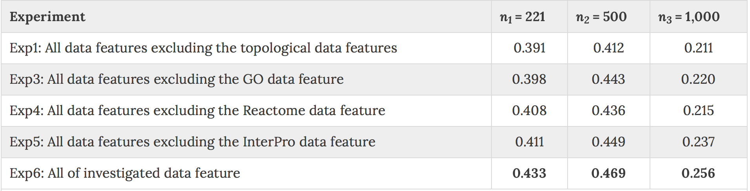
Results
Are there particular data features (from the 5 different ones in our relational database), that the rules seem to use more of?
Leave-one-out experiment for each feature
Calculate likelihood lift subsequently
Table 3. Performance of MRAM in term of likelihood lift with different subsets of data features and the three sets of negative examples with different sizes.

Slide 41
Graphlet (Dominating Biological Networks)
“Biologically central” genes are expected to exhibit some topological centrality to the rest of the proteins in the human PPI network.
Graphlet = induced subgraph of a large network
Notes:
Biologically central = involved in aging, cancer, infectious diseases caused by bacterial/viral pathogens

Slide 42
Drugbank & Clinicaltrials.gov
Drugbank
4800 drug entries (FDA approved, experimental)
Clinicaltrials.gov
NIH funded
Registry and results database
Publicly and privately supported clinical studies
Human participants
Intervention or retrospective studies also included
Query uses MeSH terms
MeSH (Medical Subject Headings)
Tree with 16 main branches (organisms, diseases, drugs etc)
Index articles using a controlled vocabulary

Slide 43
Reactome
Curated, peer-reviewed knowledgbase of biological pathways
Includes metabolic pathways, protein trafficking and signaling pathways
Reactions : experimentally confirmed, manually inferred, and electronically inferred
>2700 proteins, 2800 reactions ,and 860 human pathways.
Has GeneOntology Ids for metabolic process of each reaction

Slide 44
Interologous Interaction Database
Maps experimental interactions determined in model organisms, into human interactions
Contains predicted interactions among human proteins
1. Kirouac, Daniel C., Julio Saez-Rodriguez, Jennifer Swantek, John M. Burke, Douglas A. Lauffenburger, and Peter K. Sorger. 2012. Creating and analyzing pathway and protein interaction compendia for modelling signal transduction networks. BMC Systems Biology 6:29.

Slide 45
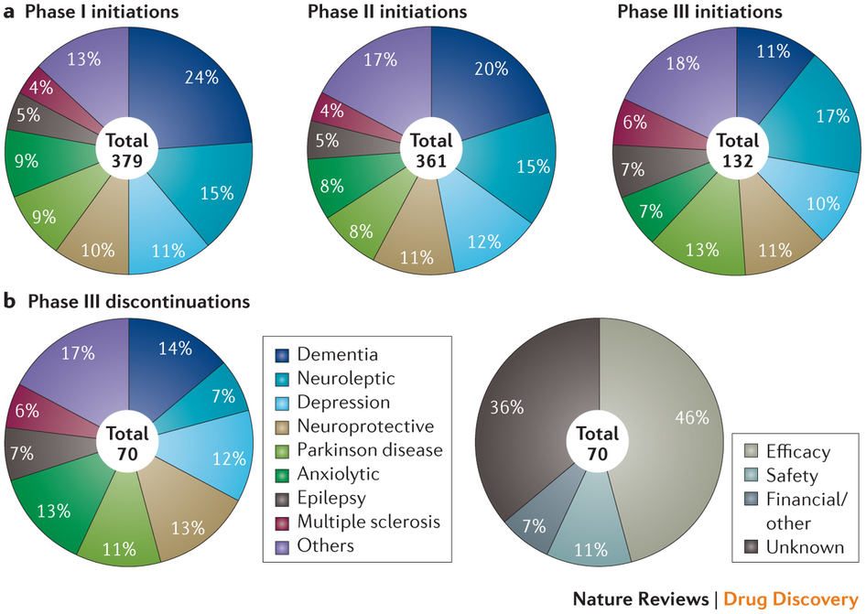
Drugs in clinical trials for central nervous system disorders: 1990–2012.
46% (32) drugs were discontinued owing to inadequate efficacy (generally described as no improvement vs placebo)
1. Kesselheim et al. Two decades of new drug development for central nervous system disorders. Published online 20 November 2015.

